Slide 1
Bayesian networks

Slide 2
Outline
Syntax
Semantics

Slide 3
Bayesian networks
A simple, graphical notation for conditional independence assertions and hence for compact specification of full joint distributions
Syntax:
  a set of nodes, one per variable
  a directed, acyclic graph (link ≈ "directly influences")
  a conditional distribution for each node given its parents:
    P (X_{i} | Parents (X_{i}))
In the simplest case, conditional distribution represented as a conditional probability table (CPT) giving the distribution over X_{i} for each combination of parent values

Slide 4

Example
Topology of network encodes conditional independence assertions:
Weather is independent of the other variables
Toothache and Catch are conditionally independent given Cavity

Slide 5
Example
I'm at work, neighbor John calls to say my alarm is ringing, but neighbor Mary doesn't call. Sometimes it's set off by minor earthquakes. Is there a burglar?
Variables: Burglary, Earthquake, Alarm, JohnCalls, MaryCalls
Network topology reflects "causal" knowledge:
  A burglar can set the alarm off
  An earthquake can set the alarm off
  The alarm can cause Mary to call
  The alarm can cause John to call

Slide 6
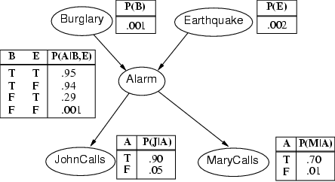
Example contd.

Slide 7
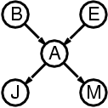
Compactness
A CPT for Boolean X_{i} with k Boolean parents has 2^{k} rows for the combinations of parent values
Each row requires one number p for X_{i} = true
(the number for X_{i} = false is just 1-p)
If each variable has no more than k parents, the complete network requires O(n · 2^{k}) numbers
I.e., grows linearly with n, vs. O(2^{n}) for the full joint distribution
For burglary net, 1 + 1 + 4 + 2 + 2 = 10 numbers (vs. 2⁵-1 = 31)

Slide 8
Semantics
The full joint distribution is defined as the product of the local conditional distributions:
P (X₁, … ,X_{n}) = π_{i = 1} P (X_{i} | Parents(X_{i}))
e.g., P(j ∧ m ∧ a ∧ ¬b ∧ ¬e)
= P (j | a) P (m | a) P (a | ¬b, ¬e) P (¬b) P (¬e)
n

Slide 9
Constructing Bayesian networks
1. Choose an ordering of variables X₁, … ,X_{n}
2. For i = 1 to n
  add X_{i} to the network
  select parents from X₁, … ,X_{i-1} such that
  P (X_{i} | Parents(X_{i})) = P (X_{i} | X₁, ... X_{i-1})
This choice of parents guarantees:
P (X₁, … ,X_{n}) = π_{i =1} P (X_{i} | X₁, … , X_{i-1})
= π_{i =1}P (X_{i} | Parents(X_{i}))
(by construction)
(chain rule)
n
n

Slide 10
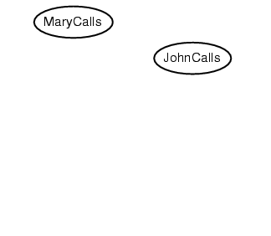
Example
Suppose we choose the ordering M, J, A, B, E
P(J | M) = P(J)?

Slide 11
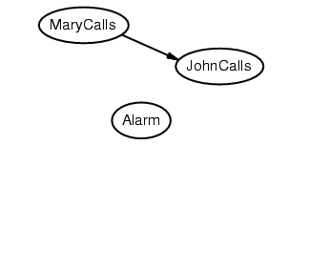
Example
Suppose we choose the ordering M, J, A, B, E
P(J | M) = P(J)?
P(A | J, M) = P(A | J)? P(A | J, M) = P(A)?
No

Slide 12
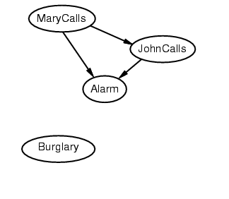
Example
Suppose we choose the ordering M, J, A, B, E
P(J | M) = P(J)?
P(A | J, M) = P(A | J)? P(A | J, M) = P(A)? No
P(B | A, J, M) = P(B | A)?
P(B | A, J, M) = P(B)?
No

Slide 13
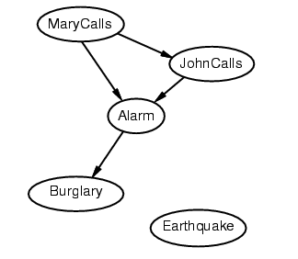
Example
Suppose we choose the ordering M, J, A, B, E
P(J | M) = P(J)?
P(A | J, M) = P(A | J)? P(A | J, M) = P(A)? No
P(B | A, J, M) = P(B | A)? Yes
P(B | A, J, M) = P(B)? No
P(E | B, A ,J, M) = P(E | A)?
P(E | B, A, J, M) = P(E | A, B)?
No

Slide 14
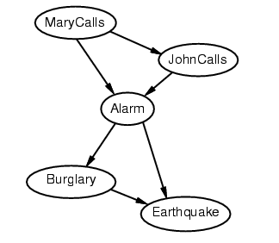
Example
Suppose we choose the ordering M, J, A, B, E
P(J | M) = P(J)?
P(A | J, M) = P(A | J)? P(A | J, M) = P(A)? No
P(B | A, J, M) = P(B | A)? Yes
P(B | A, J, M) = P(B)? No
P(E | B, A ,J, M) = P(E | A)? No
P(E | B, A, J, M) = P(E | A, B)? Yes
No

Slide 15
Example contd.
Deciding conditional independence is hard in noncausal directions
(Causal models and conditional independence seem hardwired for humans!)
Network is less compact: 1 + 2 + 4 + 2 + 4 = 13 numbers needed

Slide 16
Summary
Bayesian networks provide a natural representation for (causally induced) conditional independence
Topology + CPTs = compact representation of joint distribution
Generally easy for domain experts to construct

Slide 17
Chaining: Example
a
b c
d e
  Computing the joint probability for all variables is easy:
  P(a, b, c, d, e)
  = P(e | a, b, c, d) P(a, b, c, d) by the product rule
  = P(e | c) P(a, b, c, d) by cond. indep. assumption
  = P(e | c) P(d | a, b, c) P(a, b, c)
  = P(e | c) P(d | b, c) P(c | a, b) P(a, b)
  = P(e | c) P(d | b, c) P(c | a) P(b | a) P(a)

Slide 18
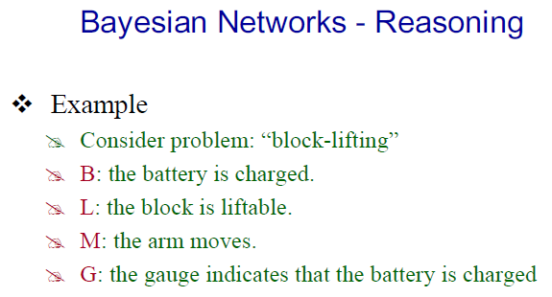

Slide 19
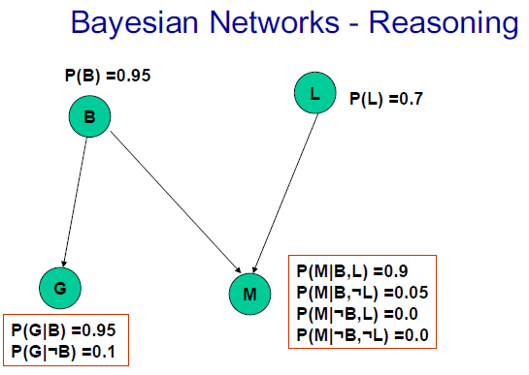

Slide 20
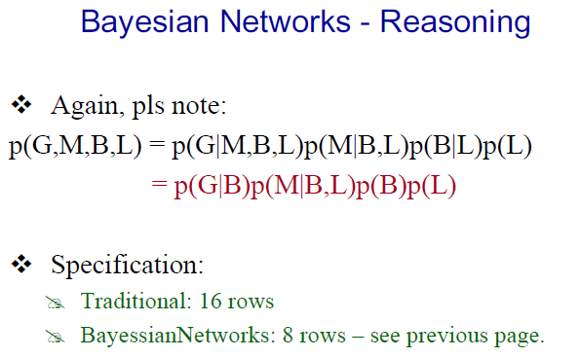

Slide 21
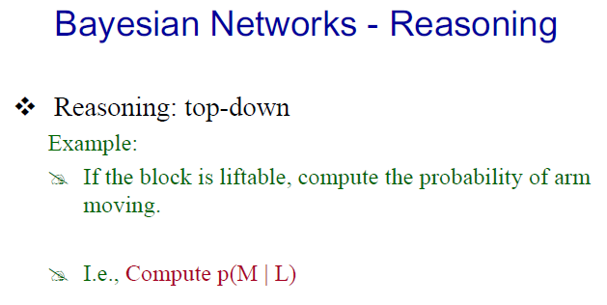
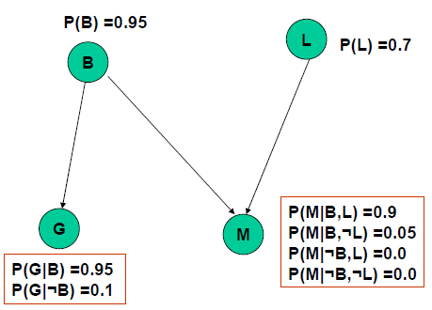

Slide 22
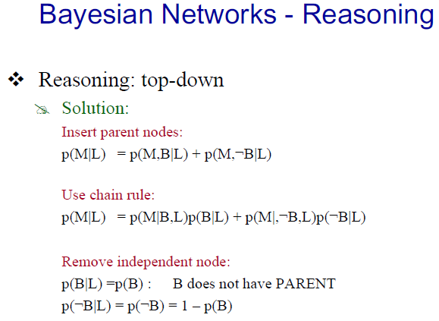


Slide 23
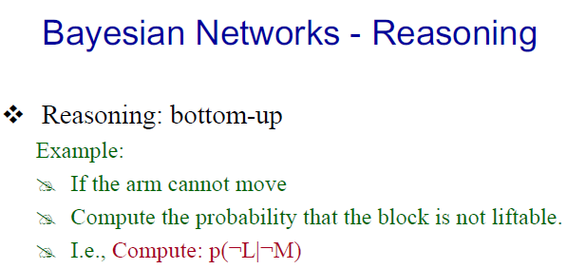

Slide 24
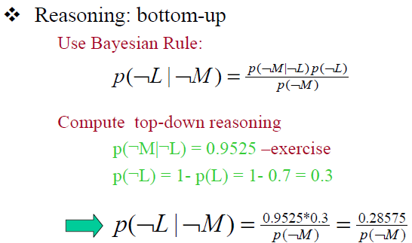
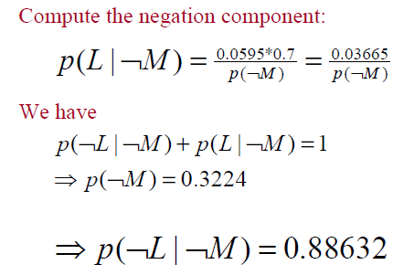

Slide 25
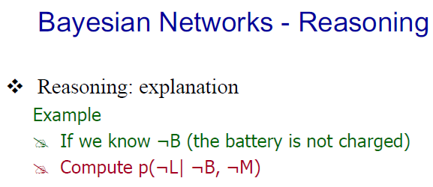

Slide 26
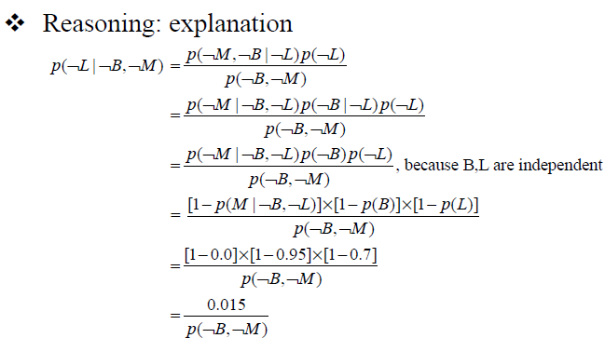
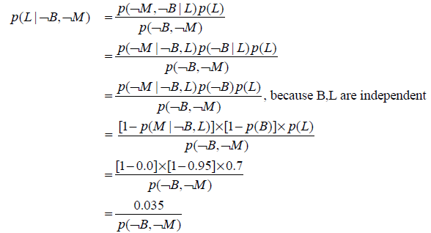

Slide 27
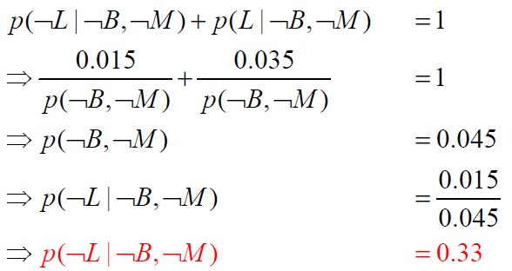

Slide 28
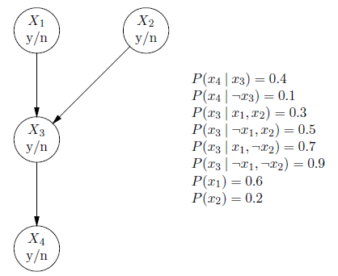
Computation of P(Xi), for i = 1, . . . , 4

Slide 29
Exercise: Enumeration
p(smart)=.8
p(study)=.6
smart
study
p(fair)=.9
prepared
fair
p(prep|…) | smart | ¬smart
study | .9 | .7
¬study | .5 | .1
pass
p(pass|…) | smart |  | ¬smart
 | prep | ¬prep | prep | ¬prep
fair | .9 | .7 | .7 | .2
¬fair | .1 | .1 | .1 | .1
Query: What is the probability that a student studied, given that they pass the exam?

